Slide 1
NEO Persistable Classes 1.0 An Efficient Object-Oriented Framework for C#.NEO Smart Contract Development
NEO Community Bluepaper
Michael Herman
https://github.com/mwherman2000/neo-persistibleclasses
neotoronto@outlook.com

Slide 2


Contributors
NEO Developer Tool Suite - CoZ Developers
@relfos – neo-debugger
@birmas – neo-gui-developer
@mwherman2000 – event log enhancements
Chris Birmingham

Slide 3
Agenda
Purpose
Scenario
Problem
Analysis
Options
Code Solution
Test Results
Roadmap
Summary
Appendix A - NEO Blockchain Architecture Reference Model (ARM)

Slide 4
0. Key Definitions
C#.MS
Version of C# supported natively by the C# compiler in Visual Studio 2017 (C# 6.0)
C#.NEO
Subset of C#.MS supported by the NEO neon.exe transcompiler (as of January 2018)
NPC
NEO Persistible Class Framework
NeoVersionedAppUser (UVA)
NEO Versioned App User objects used to create NeoStorageKeys
NeoStorageKeys (NSK)
NEO Storage Keys used to implement NPC Level 4 Collectible NPC classes

Slide 5
1. Purpose
The purpose of this presentation is to explain the key drivers for the NEO Persistible Class Framework 1.0 (NPC) as well as a range of design and implementation details including:
A fairly complete description of C#.NEO, the subset of C#.MS (C# 6.0) supported by neon.exe, the C# to NEO byte code transcompiler
Strategies and options for supporting the object programming capabilities found in C#.MS but not supported in C#.NEO
Basic guidance to smart contract development using C#.NEO
NPCdApp, the initial reference implementation for the NEO Persistible Class Framework
Inspiration (NPC Level 0)
StructExample example https://github.com/neo-project/examples-csharp/blob/master/StructExample/StructExample.cs

Slide 6
2. Scenario

Slide 7
2. Scenario
Developers on the NEO Blockchain platform have a variety of language, tools, privatenet and testnet environments as well other technology options to consider for developing smart contracts
Language options incude:
C#.NEO
Python
Java
and others
As a scenario, this document specifically targets C#.NEO smart contract development using Visual Studio

Slide 8
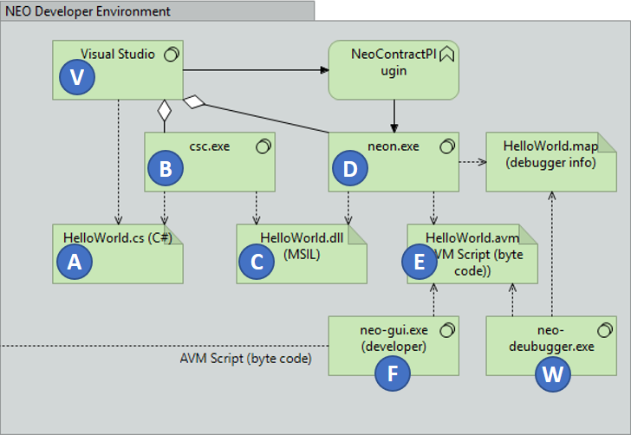





2. Scenario (con’t)
The diagram depicts a typical NEO development environment.
Developers develop their smart contract’s code using their favorite IDE and high-level programming language (HLL) (e.g. C#.MS)
The IDE’s integrated compiler compiles the HLL source into intermediate code (IL) (e.g. Microsoft Intermediate Language)
A transcompiler then translates the IL into byte code that is executable by the NEO VM (e.g. NEO VM byte code script files)
A debugger may be used to execute the VM byte code script off-chain using a VM emulator
An on-chain deployment and testing tool may be used to further test and validate the smart contract’s implementation

Slide 9
2. Scenario (con’t)
The NEO Development environment gains incredible value from leveraging the Microsoft .NET compiler stack but there is a significant challenge with this approach:
Visual Studio doesn't know anything the instruction set that the NEO VM supports
The C#.MS compiler implements the full C# 6.0 specification and knows how to generate MSIL (MS Intermediate Language) code (DLL assembly files) for the full C#.MS language
On the other hand, the C#.NEO compiler (neon.exe) only supports a subset of the MSIL patterns generated by the MS compiler.
neon.exe reads MSIL files and transcompiles the logic into NEO byte code script files (.AVM files) and generates an error when an unsupported MSIL pattern is encountered
I call this subset of C#.MS that is ultimately supported in the NEO VM: C#.NEO
What are the supported patterns of MSIL that neon.exe supports?
What are the good/better/best patterns to use?
How do you work around what is important but not supported in C#.NEO?

Slide 10
3. Problem

Slide 11
3. Problem
Given that the subset of C#.MS that is supported by neon.exe (and the NEO VM) is not documented, how to we proceed to exploit the capabilities of C#.NEO?
What are the supported patterns of MSIL that neon.exe supports?
What are the good/better/best patterns to use?
How do you work around what is important but not supported in C#.NEO?
How do we use C#.NEO for sophisticated object-oriented development?
How do we support C# classes that are nothing more elaborate than C++/C## structs?
public class Point /* Level 0 */
{
private BigInteger _x;
private BigInteger _y;
// Factory methods
private Point()
{
}
}

Slide 12
4. Analysis

Slide 13
4. Analysis
What works in C#.NEO? What doesn’t? What are the (good) workarounds?
C#.MS | C#.MS | NPC Solution
Class constructor (parameterless) | Supported: field layout only | public static p New() class method private static _Initialize(p) class method
Class constructor (with parameters) | Not supported: ignored | public static p New(x,y) class method
Class constructor logic | Not supported: ignored | public static Foobar(x,y) class methods
Properties (get()/put()) | Not supported | public static SetX/GetX/Set() class methods
null valued variables | Not supported | EntityState _state field; public static IsNull(p)
Floating-point data types | Not supported | Native Storage datatypes: string, byte[], BigInteger Limited datatypes: int/Int32
Integer data types (int/Int32) | Partially support
switch statements | Not predictable | Use if-then-else if-then-else if-…

Slide 14
4. Analysis (con’t)
C#.MS | C#.MS | NPC Solution
Declare fixed size byte[100] | Not supported | Use bye[].Concat(byte[])
Assignment to element of byte[] array: a[i] = 0x12; | Not supported | Use bye[].Concat(byte[])
0x0123456789abcdef.ToString() | Not supported | Neo.SmartContract.Framework.Helper.AsString(byte[])
((BigInteger)0x0123456789abcdef) .ToString() | Not supported
((BigInteger)0x0123456789abcdef) .ToByteArray().ToString() | Not supported | ((BigInteger)0x0123456789abcdef) .AsByteArray().AsString()
enum enumerations at int’s (internally) | Supported | int/Int32 are supported but not native C#.NEO Storage datatypes Be prepared to do lots of coercions

Slide 15
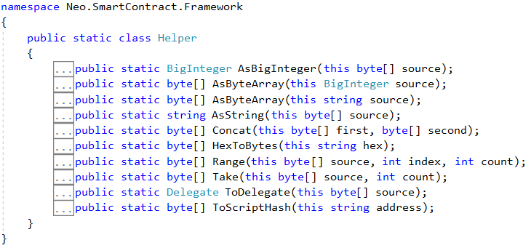
4. Analysis (con’t)

Slide 16
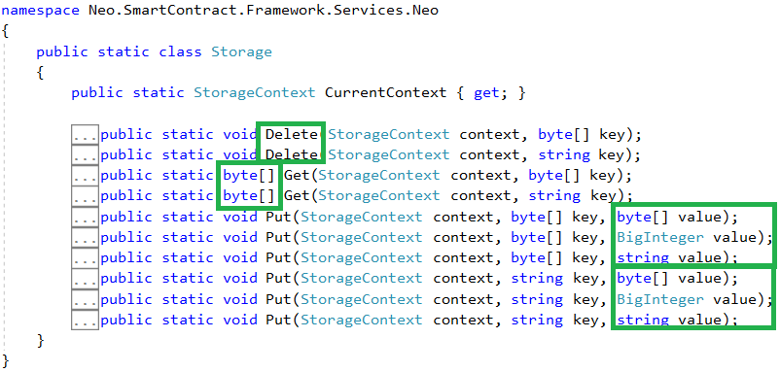
4. Analysis (con’t)

Slide 17
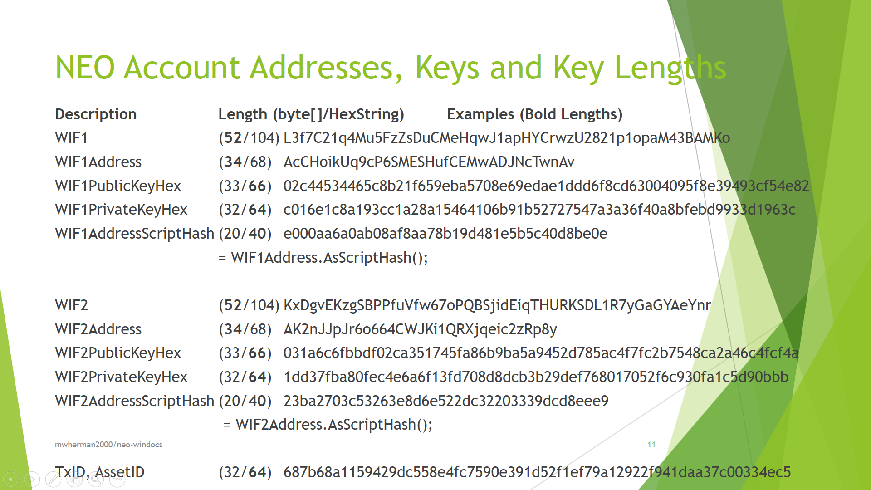
4. Analysis (con’t)

Slide 18
5. Options

Slide 19
5. Options
Model every class as a C#.NEO Class
Fields
Only string, byte[], or BigInteger data types
Especially if there is any chance of class being persisted
Constructors
Every class has a private parameterless constructor that is never used
Every class has public New() and public New(x,y)
All class methods modeled as public static methods
Entity passed as the first parameter (except Log() and LogExt() methods)
null valued variables
Start adding “system” fields to each class: private EntityType _state;
static public wrapper methods for all system fields (scope private)
Use byte[] when possible to minimize Storage as well as being the easiest to work with from a supported runtime library perspective

Slide 20
5. Options (con’t)
Model every classes as a C#.NEO Class with the following characteristics:
All NPC have the same minimum set of default public static methods with the set of methods varying with the NPC Level being implemented for the class:
NPC Level 0 Basic
NPC Level 1 Managed
NPC Level 2 Persistable
NPC Level 3 Deletable (Bury/Tombstone)
NPC Level 4 Collectible
NPC Level 5 Extendible (Roadmap)
NPC Level 6 Authorized (Roadmap)
NPC Level 6 Optimized (Roadmap)
NOTE: Primary driver for NPC Levels is minimizing code size by implementing only the Levels (and methods) required by the specific class

Slide 21
6. Solution

Slide 22
6. Solution
NPC Level 0 Basic
NPC Level 1 Managed
NPC Level 2 Persistable
NPC Level 3 Deletable (Bury/Tombstone)
NPC Level 4 Collectible
NPC Level 5 Extendible (Roadmap)
NPC Level 6 Authorized (Roadmap)
NPC Level 6 Optimized (Roadmap)

Slide 23
6. Solution – NPC Level 0 Basic

Slide 24
NPC Level 0 Basic - Point
public class Point /* Level 0 */
{
private BigInteger _x;
private BigInteger _y;
}

Slide 25
6. Solution – NPC Level 1 Managed

Slide 26
NPC Level 1 Managed – NeoTrace
public class NeoTrace /* Level *all* */
{
public static void Trace(params object[] args)
{
Neo.SmartContract.Framework.Services.Neo.Runtime.Notify(args);
}
}

Slide 27
NPC Level 1 Managed – NeoEntityModel
public static class NeoEntityModel /* Level 1 */
{
public enum EntityState
{
NULL, INIT, SET
}
public static BigInteger AsBigInteger(this EntityState sta)
{
int istate = (int)sta;
BigInteger bis = istate;
return bis;
}
public static EntityState BytesToEntityState(byte[] bsta)
{
int ista = (int)bsta.AsBigInteger();
NeoEntityModel.EntityState sta = (NeoEntityModel.EntityState)ista;
return sta;
}
}

Slide 28
NPC Level 1 Managed – Point
public class Point : NeoTrace /* Level 1 */
{
private BigInteger _x;
private BigInteger _y;
private NeoEntityModel.EntityState _state;
// Accessors
public static void SetX(Point p, BigInteger value)
{ p._x = value; p._state = NeoEntityModel.EntityState.SET; }
public static BigInteger GetX(Point p) { return p._x; }
public static void SetY(Point p, BigInteger value)
{ p._y = value; p._state = NeoEntityModel.EntityState.SET; }
public static BigInteger GetY(Point p) { return p._y; }
public static void Set(Point p, BigInteger xvalue, BigInteger yvalue)
{ p._x = xvalue; p._y = yvalue; p._state = NeoEntityModel.EntityState.SET; }

Slide 29
NPC Level 1 Managed – Point (con’t)
// Factory methods
private Point()
{
}
private static Point _Initialize(Point p)
{
p._x = 0;
p._y = 0;
p._state = NeoEntityModel.EntityState.NULL; ;
LogExt("_Initialize(p).p", p);
return p;
}
public static Point New()
{
Point p = new Point();
_Initialize(p);
LogExt("New().p", p);
return p;
}

Slide 30
NPC Level 1 Managed – Point (con’t)
public static Point New(int x, int y)
{
Point p = new Point();
p._x = x;
p._y = y;
p._state = NeoEntityModel.EntityState.INIT;
LogExt("New(x,y).p", p);
return p;
}
public static Point Null()
{
Point p = new Point();
_Initialize(p);
LogExt("Null().p", p);
return p;
}

Slide 31
NPC Level 1 Managed – Point (con’t)
// EntityState wrapper methods
public static bool IsNull(Point p)
{
return (p._state == NeoEntityModel.EntityState.NULL);
}
// Log/trace methods
public static void Log(string label, Point p)
{
NeoTrace.Trace(label, p._x, p._y);
}
public static void LogExt(string label, Point p)
{
NeoTrace.Trace(label, p._x, p._y, p._state);
}
}

Slide 32
6. Solution – NPC Level 2 Persistable

Slide 33
NPC Level 2 Persistable - NeoEntityModel
public static class NeoEntityModel /* Level 2 Persistible */
{
public enum EntityState
{
NULL, INIT, SET, PUTTED, GETTED, MISSING
}
public static BigInteger AsBigInteger(this EntityState state)
{
int istate = (int)state;
BigInteger bis = istate;
return bis;
}
public static EntityState BytesToEntityState(byte[] bsta)
{
int ista = (int)bsta.AsBigInteger();
NeoEntityModel.EntityState sta = (NeoEntityModel.EntityState)ista;
return sta;
}
}

Slide 34
NPC Level 2 Persistable – Point
public class Point : NeoTrace /* Level 2 Persistible */
{
private BigInteger _x;
private BigInteger _y;
private NeoEntityModel.EntityState _state;
// Accessors
public static void SetX(Point p, BigInteger value)
{ p._x = value; p._state = NeoEntityModel.EntityState.SET; }
public static BigInteger GetX(Point p) { return p._x; }
public static void SetY(Point p, BigInteger value)
{ p._y = value; p._state = NeoEntityModel.EntityState.SET; }
public static BigInteger GetY(Point p) { return p._y; }
public static void Set(Point p, BigInteger xvalue, BigInteger yvalue)
{ p._x = xvalue; p._y = yvalue; p._state = NeoEntityModel.EntityState.SET; }

Slide 35
NPC Level 2 Persistable – Point (con’t)
// Class name and property names
private const string _className = "Point";
private const string _sX = "X";
private const string _sY = "Y";
private const string _sSTA = "_STA";
private const string _sEXT = "_EXT";
private static readonly byte[] _bX = Helper.AsByteArray(_sX);
private static readonly byte[] _bY = Helper.AsByteArray(_sY);
private static readonly byte[] _bSTA = Helper.AsByteArray(_sSTA);
private static readonly byte[] _bEXT = Helper.AsByteArray(_sEXT);
// Internal fields
private const string _classKeyTag = "/#" + _className + ".";
private static readonly byte[] _bclassKeyTag = Helper.AsByteArray(_classKeyTag);

Slide 36
NPC Level 2 Persistable – Point (con’t)
// Factory methods
private Point()
{
}
private static Point _Initialize(Point p)
{
p._x = 0; p._y = 0;
p._state = NeoEntityModel.EntityState.NULL; ;
LogExt("_Initialize(p).p", p);
return p;
}
public static Point New()
{
Point p = new Point();
_Initialize(p);
LogExt("New().p", p);
return p;
}

Slide 37
NPC Level 2 Persistable – Point (con’t)
public static Point New(int x, int y)
{
Point p = new Point();
p._x = x; p._y = y;
p._state = NeoEntityModel.EntityState.INIT;
LogExt("New(x,y).p", p);
return p;
}
public static Point Null()
{
Point p = new Point();
_Initialize(p);
LogExt("Null().p", p);
return p;
}

Slide 38
NPC Level 2 Persistable – Point (con’t)
// EntityState wrapper methods
public static bool IsNull(Point p)
{
return (p._state == NeoEntityModel.EntityState.NULL);
}
// Log/trace methods
public static void Log(string label, Point p)
{
NeoTrace.Trace(label, p._x, p._y);
}
public static void LogExt(string label, Point p)
{
NeoTrace.Trace(label, p._x, p._y, p._state);
}

Slide 39
NPC Level 2 Persistable – Point (con’t)
// Persistable methods
public static bool IsMissing(Point p)
{
return (p._state == NeoEntityModel.EntityState.MISSING);
}
public static Point Missing()
{
Point p = new Point();
p._x = 0; p._y = 0;
p._state = NeoEntityModel.EntityState.MISSING;
LogExt("Missing().p", p);
return p;
}

Slide 40
NPC Level 2 Persistable – Point (con’t)
public static bool Put(Point p, byte[] key)
{
if (key.Length == 0) return false;
Neo.SmartContract.Framework.Services.Neo.StorageContext ctx =
Neo.SmartContract.Framework.Services.Neo.Storage.CurrentContext;
byte[] _bkeyTag = Helper.Concat(key, _bclassKeyTag);
p._state = NeoEntityModel.EntityState.PUTTED;
Neo.SmartContract.Framework.Services.Neo.Storage.Put(ctx,
Helper.Concat(_bkeyTag, _bSTA), p._state.AsBigInteger());
Neo.SmartContract.Framework.Services.Neo.Storage.Put(ctx,
Helper.Concat(_bkeyTag, _bX), p._x);
Neo.SmartContract.Framework.Services.Neo.Storage.Put(ctx,
Helper.Concat(_bkeyTag, _bY), p._y);
LogExt("Put(bkey).p", p);
return true;
}

Slide 41
NPC Level 2 Persistable – Point (con’t)
public static Point Get(byte[] key)
{
if (key.Length == 0) return Null();
Neo.SmartContract.Framework.Services.Neo.StorageContext ctx =
Neo.SmartContract.Framework.Services.Neo.Storage.CurrentContext;
byte[] _bkeyTag = Helper.Concat(key, _bclassKeyTag);
Point p;
byte[] bsta = Neo.SmartContract.Framework.Services.Neo.Storage.Get(ctx, Helper.Concat(_bkeyTag, _bSTA));
NeoTrace.Trace("Get(kb).bs", bsta.Length, bsta);
if (bsta.Length == 0)
{
p = Point.Missing();
}
else // not MISSING
{
byte[] bext = Neo.SmartContract.Framework.Services.Neo.Storage.Get(ctx, Helper.Concat(_bkeyTag, _bEXT));
int ista = (int)bsta.AsBigInteger();
NeoEntityModel.EntityState sta = (NeoEntityModel.EntityState)ista;
p = new Point();
BigInteger x = Neo.SmartContract.Framework.Services.Neo.Storage.Get(ctx,
Helper.Concat(_bkeyTag, _bX)).AsBigInteger();
BigInteger y = Neo.SmartContract.Framework.Services.Neo.Storage.Get(ctx,
Helper.Concat(_bkeyTag, _bY)).AsBigInteger();
p._x = x; p._y = y; p._state = sta;
p._state = NeoEntityModel.EntityState.GETTED; /* OVERRIDE */
}
LogExt("Get(kb).p", p);
return p;
}

Slide 42
NPC Level 2 Persistable – Point (con’t)
public static Point Get(byte[] key)
{
if (key.Length == 0) return Null();
Neo.SmartContract.Framework.Services.Neo.StorageContext ctx =
Neo.SmartContract.Framework.Services.Neo.Storage.CurrentContext;
byte[] _bkeyTag = Helper.Concat(key, _bclassKeyTag);
Point p;
byte[] bsta = Neo.SmartContract.Framework.Services.Neo.Storage.Get(ctx, Helper.Concat(_bkeyTag, _bSTA));
NeoTrace.Trace("Get(kb).bs", bsta.Length, bsta);
if (bsta.Length == 0)
{
p = Point.Missing();
}
else // not MISSING
{
byte[] bext = Neo.SmartContract.Framework.Services.Neo.Storage.Get(ctx, Helper.Concat(_bkeyTag, _bEXT));
int ista = (int)bsta.AsBigInteger();
NeoEntityModel.EntityState sta = (NeoEntityModel.EntityState)ista;
p = new Point();
BigInteger x = Neo.SmartContract.Framework.Services.Neo.Storage.Get(ctx,
Helper.Concat(_bkeyTag, _bX)).AsBigInteger();
BigInteger y = Neo.SmartContract.Framework.Services.Neo.Storage.Get(ctx,
Helper.Concat(_bkeyTag, _bY)).AsBigInteger();
p._x = x; p._y = y; p._state = sta;
p._state = NeoEntityModel.EntityState.GETTED; /* OVERRIDE */
}
LogExt("Get(kb).p", p);
return p;
}

Slide 43
6. Solution – NPC Level 3 Deletable

Slide 44
NPC Level 3 Deletable - NeoEntityModel
public static class NeoEntityModel /* Level 3 Deletable */
{
public enum EntityState
{
NULL, INIT, SET, PUTTED, GETTED, MISSING, TOMBSTONED
}
public static BigInteger AsBigInteger(this EntityState state)
{
int istate = (int)state;
BigInteger bis = istate;
return bis;
}
public static EntityState BytesToEntityState(byte[] bsta)
{
int ista = (int)bsta.AsBigInteger();
NeoEntityModel.EntityState sta = (NeoEntityModel.EntityState)ista;
return sta;
}
}

Slide 45
NPC Level 3 Deletable - Point
...
// Persistable methods
public static bool IsMissing(Point p)
{
return (p._state == NeoEntityModel.EntityState.MISSING);
}
public static Point Missing()
{
Point p = new Point();
p._x = 0;
p._y = 0;
p._state = NeoEntityModel.EntityState.MISSING;
LogExt("Missing().p", p);
return p;
}
...

Slide 46
NPC Level 3 Deletable – Point (con’t)
...
// Deletable methods
public static bool IsBuried(Point p)
{
return (p._state == NeoEntityModel.EntityState.TOMBSTONED);
}
public static Point Tombstone()
{
Point p = new Point();
p._x = 0;
p._y = 0;
p._state = NeoEntityModel.EntityState.TOMBSTONED;
LogExt("Tombstone().p", p);
return p;
}
...

Slide 47
NPC Level 3 Deletable – Point (con’t)
...
public static Point Bury(byte[] key)
{
if (key.Length == 0) return Null();
Neo.SmartContract.Framework.Services.Neo.StorageContext ctx =
Neo.SmartContract.Framework.Services.Neo.Storage.CurrentContext;
byte[] _bkeyTag = Helper.Concat(key, _bclassKeyTag);
Point p;
byte[] bsta = Neo.SmartContract.Framework.Services.Neo.Storage.Get(ctx, Helper.Concat(_bkeyTag, _bSTA));
NeoTrace.Trace("Bury(kb).bs", bsta.Length, bsta);
if (bsta.Length == 0)
{
p = Point.Missing();
}
else // not MISSING - bury it
{
p = Point.Tombstone();
Neo.SmartContract.Framework.Services.Neo.Storage.Put(ctx,
Helper.Concat(_bkeyTag, _bSTA), p._state.AsBigInteger());
Neo.SmartContract.Framework.Services.Neo.Storage.Put(ctx, Helper.Concat(_bkeyTag, _bX), p._x);
Neo.SmartContract.Framework.Services.Neo.Storage.Put(ctx, Helper.Concat(_bkeyTag, _bY), p._y);
}
LogExt("Bury(kb).p", p);
return p; // return Point p to signal if key is Missing or bad key
}
...

Slide 48
6. Solution – NPC Level 4 Collectible

Slide 49
NPC Level 4 Collectible - NeoEntityModel
public static class NeoEntityModel /* Level 4 Collectible */
{
public enum EntityState
{
NULL, INIT, SET, PUTTED, GETTED, MISSING, TOMBSTONED, NOTAUTHORIZED /* Future */
}
public static BigInteger AsBigInteger(this EntityState state)
{
int istate = (int)state;
BigInteger bis = istate;
return bis;
}
public static EntityState BytesToEntityState(byte[] bsta)
{
int ista = (int)bsta.AsBigInteger();
NeoEntityModel.EntityState sta = (NeoEntityModel.EntityState)ista;
return sta;
}
public static readonly byte[] NullScriptHash = "".ToScriptHash();
public static readonly byte[] NullByteArray = "".AsByteArray();
}

Slide 50
NPC Level 4 Collectible - NeoVersionedAppUser
public class NeoVersionedAppUser
{
private byte[] _app;
private int _major;
private int _minor;
private int _build;
private byte[] _userScriptHash;
private NeoEntityModel.EntityState _state;

Slide 51
NPC Level 4 Collectible – NeoVersionedAppUser
public static void SetAppName(NeoVersionedAppUser vau, byte[] value)
{ vau._app = value; vau._state = NeoEntityModel.EntityState.SET; }
public static byte[] GetAppNameAsByteArray(NeoVersionedAppUser vau) { return vau._app; }
public static void SetAppName(NeoVersionedAppUser vau, string value)
{ vau._app = value.AsByteArray(); vau._state = NeoEntityModel.EntityState.SET; }
public static string GetAppNameAsString(NeoVersionedAppUser vau) { return vau._app.AsString(); }
public static void SetMajor(NeoVersionedAppUser vau, int value)
{ vau._major = value; vau._state = NeoEntityModel.EntityState.SET; }
public static int GetMajor(NeoVersionedAppUser vau) { return vau._major; }
public static void SetMinor(NeoVersionedAppUser vau, int value)
{ vau._minor = value; vau._state = NeoEntityModel.EntityState.SET; }
public static int GetMinor(NeoVersionedAppUser vau) { return vau._minor; }
public static void SetBuild(NeoVersionedAppUser vau, int value)
{ vau._build = value; vau._state = NeoEntityModel.EntityState.SET; }
public static int GetBuild(NeoVersionedAppUser vau) { return vau._build; }
public static void SetUserScriptHash(NeoVersionedAppUser vau, byte[] value)
{ vau._userScriptHash = value; vau._state = NeoEntityModel.EntityState.SET; }
public static byte[] GetUserScriptHash(NeoVersionedAppUser vau) { return vau._userScriptHash; }
public static void Set(NeoVersionedAppUser vau, byte[] app, int major, int minor, int build, byte[] userScriptHash)
{
vau._app = app; vau._major = major; vau._minor = minor; vau._build = build;
vau._userScriptHash = userScriptHash; vau._state = NeoEntityModel.EntityState.SET;
}
public static void Set(NeoVersionedAppUser vau, string app, int major, int minor, int build, byte[] userScriptHash)
{
vau._app = app.AsByteArray(); vau._major = major; vau._minor = minor; vau._build = build;
vau._userScriptHash = userScriptHash; vau._state = NeoEntityModel.EntityState.SET;
}

Slide 52
NPC Level 4 Collectible - NeoStorageKey
public class NeoStorageKey
{
private byte[] _app;
private int _major;
private int _minor;
private int _build;
private byte[] _userScriptHash;
private byte[] _className;
private int _index;
private string _fieldName;
private NeoEntityModel.EntityState _state;

Slide 53
NPC Level 4 Collectible – NeoStorageKey (con’t)
public static NeoStorageKey New(NeoVersionedAppUser vau, byte[] className)
{
if (NeoVersionedAppUser.IsNull(vau))
{
return NeoStorageKey.Null();
}
NeoStorageKey nsk = new NeoStorageKey();
nsk._app = NeoVersionedAppUser.GetAppNameAsByteArray(vau);
nsk._major = NeoVersionedAppUser.GetMajor(vau);
nsk._minor = NeoVersionedAppUser.GetMinor(vau);
nsk._build = NeoVersionedAppUser.GetBuild(vau);
nsk._userScriptHash = NeoVersionedAppUser.GetUserScriptHash(vau);
nsk._className = className;
nsk._index = 0;
nsk._fieldName = "";
nsk._state = NeoEntityModel.EntityState.INIT;
LogExt("New(vau,bc)", nsk);
return nsk;
}

Slide 54
NPC Level 4 Collectible – NeoStorageKey (con’t)
private static readonly byte[] _bLeftBrace = "{".AsByteArray();
private static readonly byte[] _bRightBrace = "}".AsByteArray();
private static readonly byte[] _bColon = ":".AsByteArray();
private static readonly byte[] _bEquals = "=".AsByteArray();
private static readonly byte[] _bSemiColon = ";".AsByteArray();
private static readonly byte[] _ba = "a".AsByteArray(); // App name
private static readonly byte[] _bM = "M".AsByteArray(); // App major version
private static readonly byte[] _bm = "m".AsByteArray(); // App minor version
private static readonly byte[] _bb = "b".AsByteArray(); // App build number
private static readonly byte[] _bu = "u".AsByteArray(); // User script hash
private static readonly byte[] _bc = "c".AsByteArray(); // Class name
private static readonly byte[] _bi = "i".AsByteArray(); // Index value
private static readonly byte[] _bf = "f".AsByteArray(); // Field name
private static readonly byte[] _bStringType =
{ (byte)Neo.SmartContract.ContractParameterType.String };
private static readonly byte[] _bBigIntegerType =
{ (byte)Neo.SmartContract.ContractParameterType.Integer };
private static readonly byte[] _bUserScriptHashType =
{ (byte)Neo.SmartContract.ContractParameterType.ByteArray };

Slide 55
NPC Level 4 Collectible – NeoStorageKey (con’t)
public static byte[] StorageKey(NeoStorageKey nsk, int index, byte[] fieldName)
{
LogExt("StorageKey(nsk,i,fb).nsk", nsk);
byte[] bkey = Helper.Concat(_bLeftBrace, _ba).Concat(_bColon).Concat(_bStringType)
.Concat(_bEquals).Concat(nsk._app).Concat(_bSemiColon);
bkey = Helper.Concat(bkey, _bM).Concat(_bColon).Concat(_bBigIntegerType) .Concat(_bEquals).Concat(((BigInteger)(nsk._major)).AsByteArray()).Concat(_bSemiColon);
bkey = Helper.Concat(bkey, _bm).Concat(_bColon).Concat(_bBigIntegerType)
.Concat(_bEquals).Concat(((BigInteger)(nsk._minor)).AsByteArray()).Concat(_bSemiColon);
bkey = Helper.Concat(bkey, _bb).Concat(_bColon).Concat(_bBigIntegerType)
.Concat(_bEquals).Concat(((BigInteger)(nsk._build)).AsByteArray()).Concat(_bSemiColon);
bkey = Helper.Concat(bkey, _bu).Concat(_bColon).Concat(_bUserScriptHashType)
.Concat(_bEquals).Concat(nsk._userScriptHash).Concat(_bSemiColon);
bkey = Helper.Concat(bkey, _bc).Concat(_bColon).Concat(_bStringType)
.Concat(_bEquals).Concat(nsk._className).Concat(_bSemiColon);
bkey = Helper.Concat(bkey, _bi).Concat(_bColon).Concat(_bBigIntegerType)
.Concat(_bEquals).Concat(((BigInteger)(index)).AsByteArray()).Concat(_bSemiColon);
bkey = Helper.Concat(bkey, _bf).Concat(_bColon).Concat(_bStringType)
.Concat(_bEquals).Concat(fieldName).Concat(_bSemiColon);
bkey = Helper.Concat(bkey, _bRightBrace);
NeoTrace.Trace("StorageKey(nsk).bkey$BSK", bkey);
return bkey;
}

Slide 56
NPC Level 4 Collectible - Point
public static Point BuryElement(NeoVersionedAppUser vau, int index)
{
if (NeoVersionedAppUser.IsNull(vau)) return Point.Null();
Neo.SmartContract.Framework.Services.Neo.StorageContext ctx =
Neo.SmartContract.Framework.Services.Neo.Storage.CurrentContext;
NeoStorageKey nsk = NeoStorageKey.New(vau, "Point");
byte[] bkey;
Point p;
byte[] bsta = Neo.SmartContract.Framework.Services.Neo.Storage.Get(ctx, NeoStorageKey.StorageKey(nsk, index, _bSTA));
NeoTrace.Trace("Bury(vau,index).bs", bsta.Length, bsta);
if (bsta.Length == 0)
{
p = Point.Missing();
}
else // not MISSING - bury it
{
p = Point.Tombstone();
Neo.SmartContract.Framework.Services.Neo.Storage.Put(ctx, NeoStorageKey.StorageKey(nsk, index, _bSTA),
p._state.AsBigInteger());
Neo.SmartContract.Framework.Services.Neo.Storage.Put(ctx, NeoStorageKey.StorageKey(nsk, index, _bEXT),
p._extension);
Neo.SmartContract.Framework.Services.Neo.Storage.Put(ctx, NeoStorageKey.StorageKey(nsk, index, _bX), p._x);
Neo.SmartContract.Framework.Services.Neo.Storage.Put(ctx, NeoStorageKey.StorageKey(nsk, index, _bY), p._y);
}
LogExt("Bury(vau,i).p", p);
return p;
}

Slide 57
7. Test Results

Slide 58
7. Test Results
Test1()
Dump miscellaneous variables to the log
Test2()
NPC Level 1 test cases: Create 3 Points and a line. Add two Points. Log the results.
Test3()
NPC Level 2/3 test cases: Create 3 Points and test NPC Level 3 entity persistence. Log the results.
Test4()
NPC Level 2/3 test cases: Test IsNull(), IsMissing() and IsExtended(). Log the results.
Test5()
NPC Level 4 test cases: Test NeoStorageKeys. Log the results.
Test6()
NPC Level 4 test cases: Test NeoStorageKeys. Log the results

Slide 59
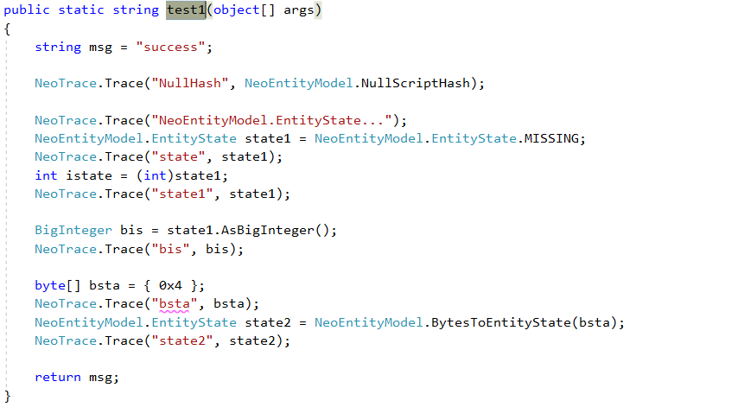
Test1() – Code

Slide 60
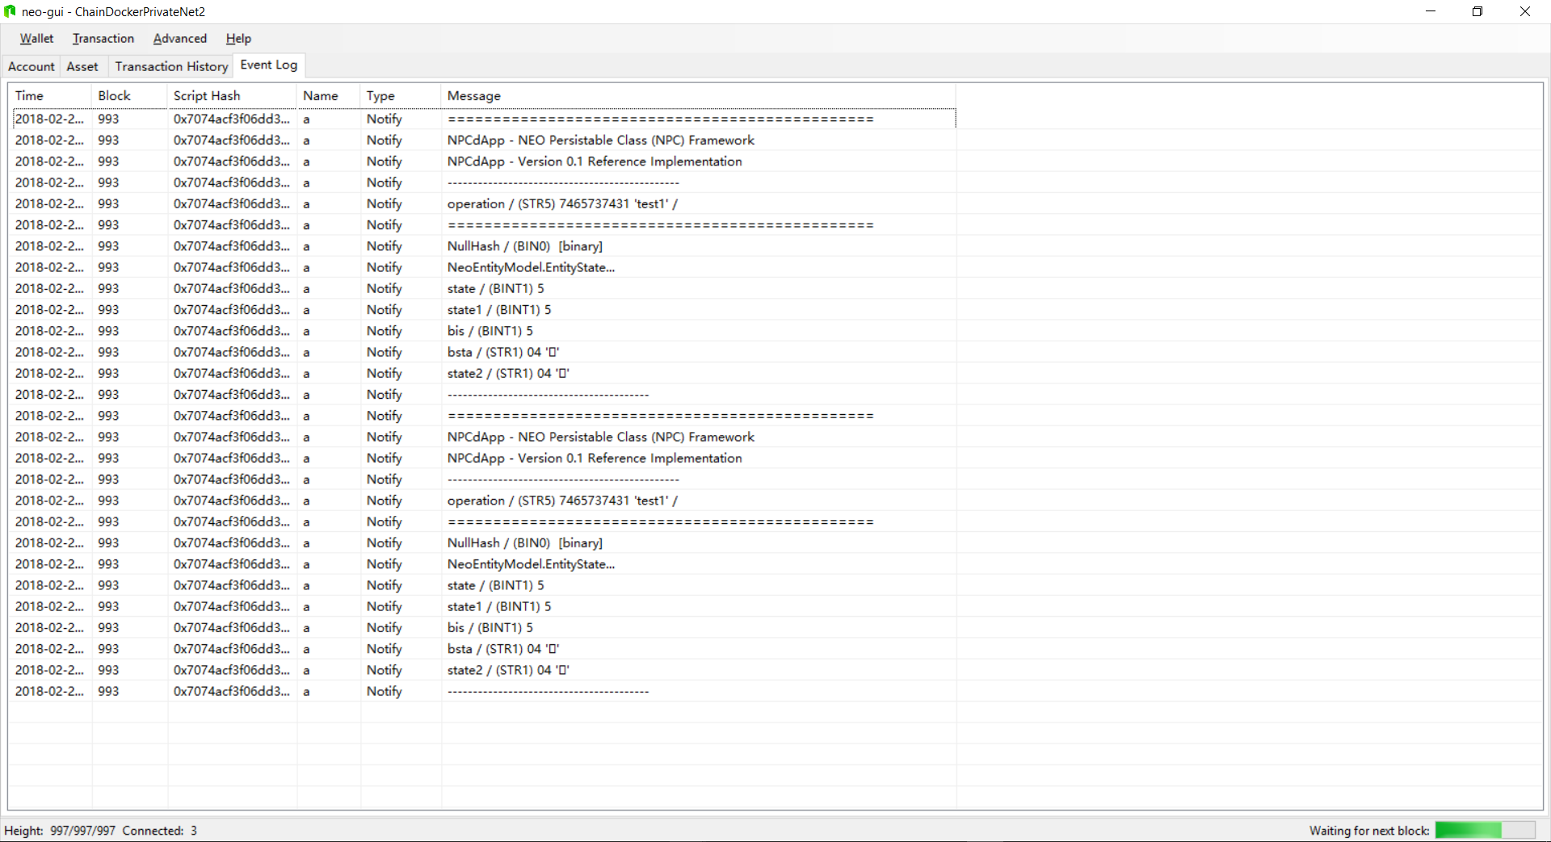
Test1() – neo-gui Event Log

Slide 61
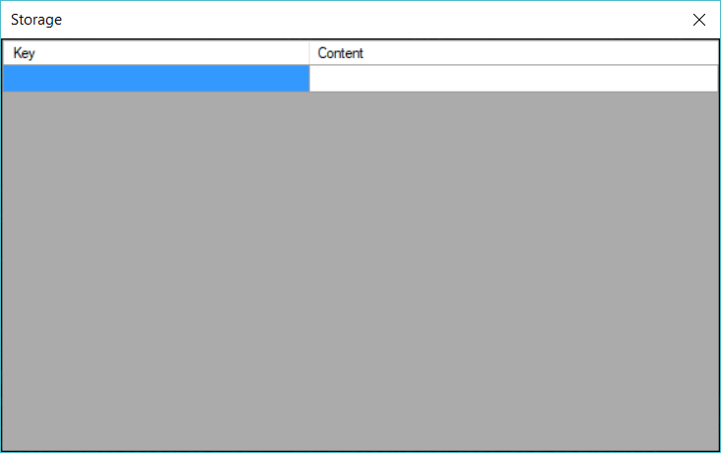
Test1() – neo-debugger Storage Viewer

Slide 62
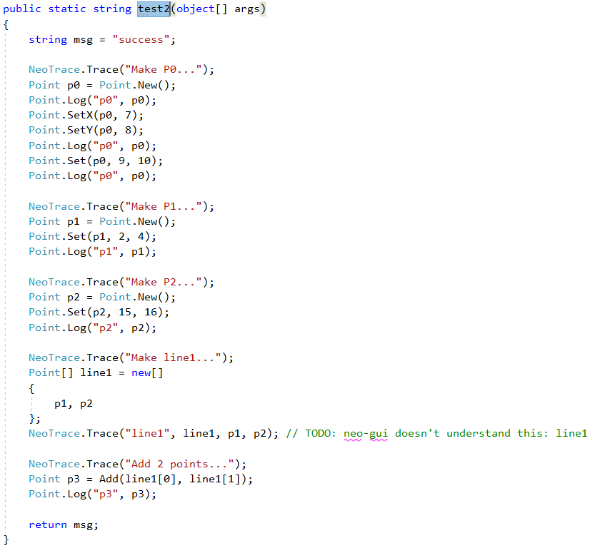
Test2() – Code

Slide 63
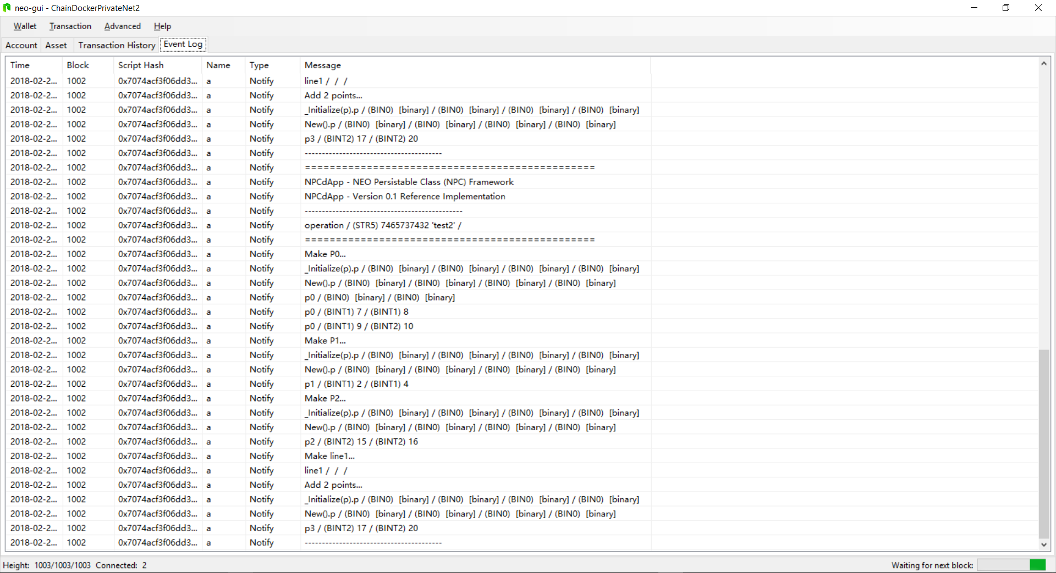
Test2() – neo-gui Event Log

Slide 64
Test2() – neo-debugger Storage Viewer

Slide 65
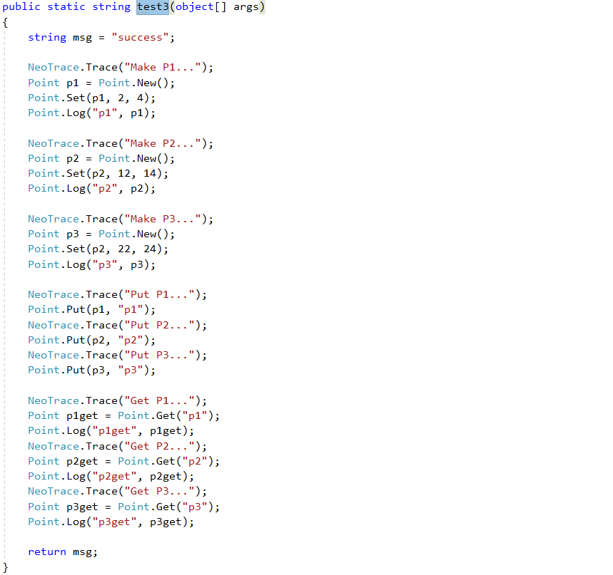
Test3() – Code

Slide 66
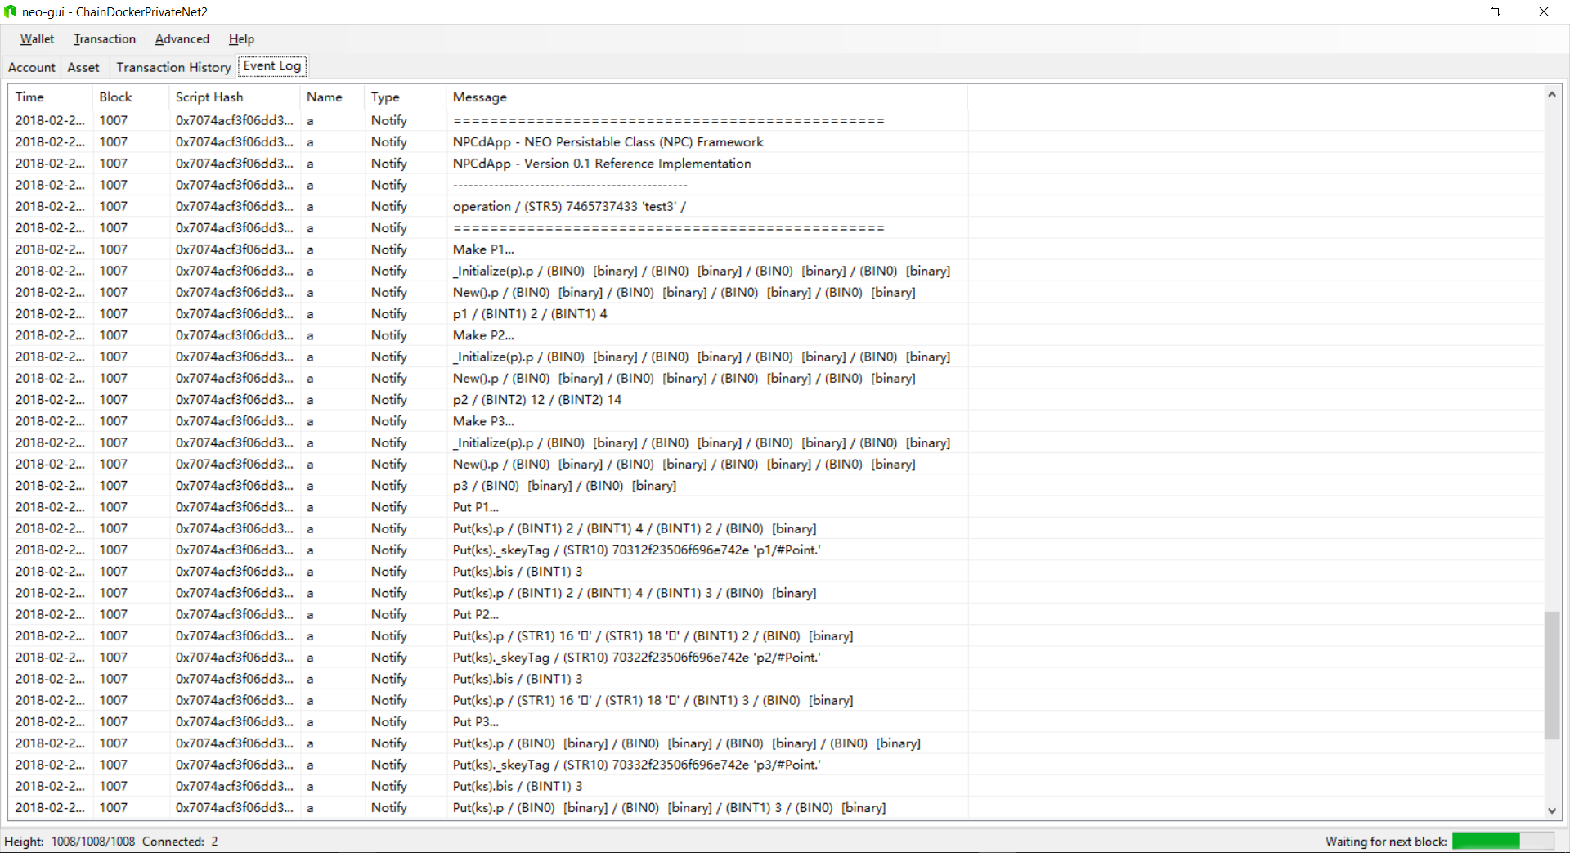
Test3() – neo-gui Event Log

Slide 67
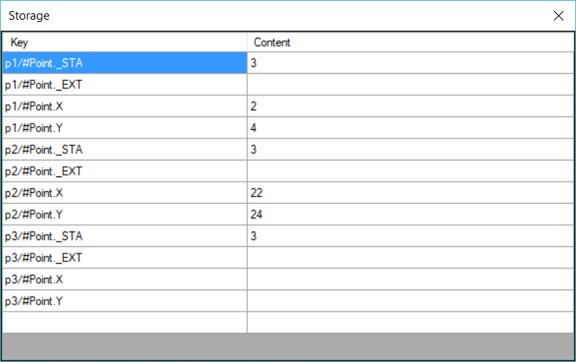
Test3() – neo-debugger Storage Viewer

Slide 68
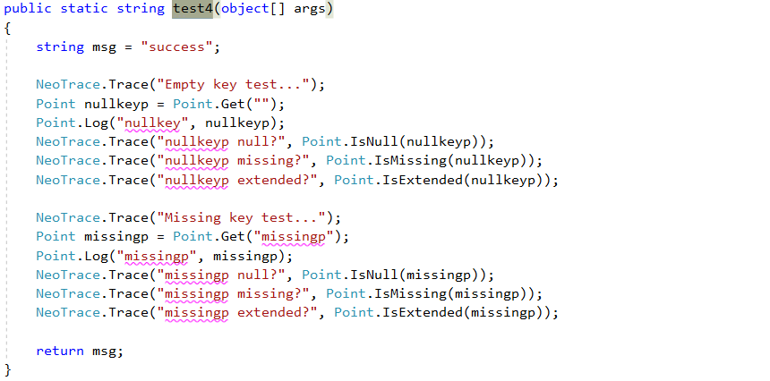
Test4() – Code

Slide 69
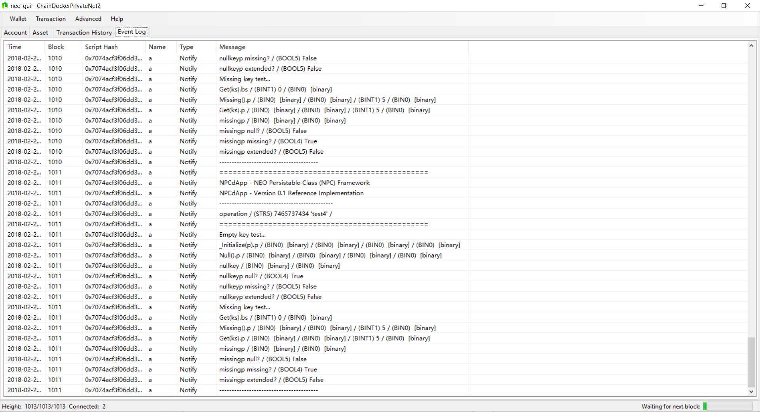
Test4() – neo-gui Event Log

Slide 70
Test4() – neo-debugger Storage Viewer

Slide 71
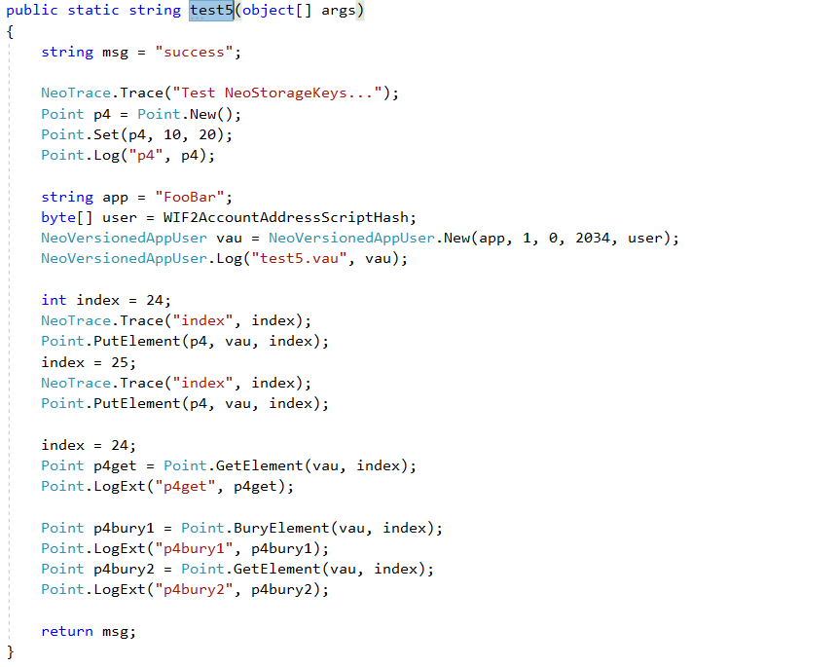
Test5() – Code

Slide 72
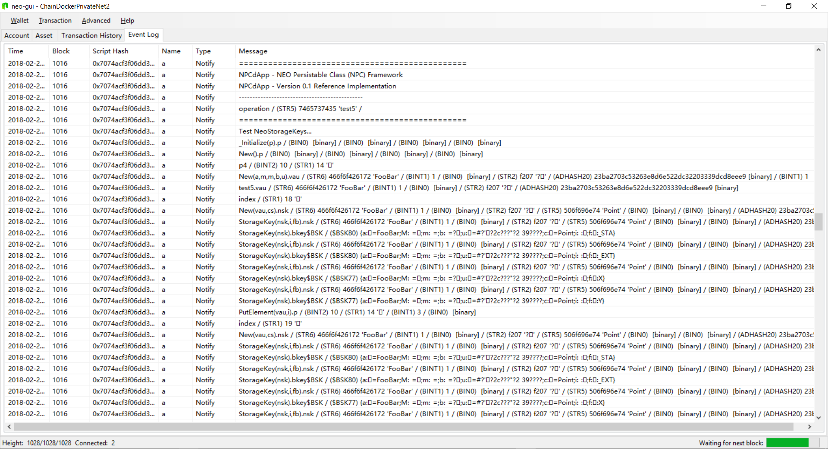
Test5() – neo-gui Event Log

Slide 73
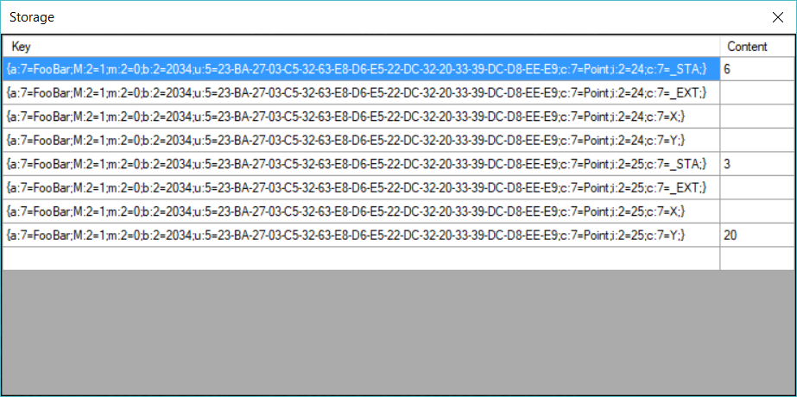
Test5() – neo-debugger Storage Viewer

Slide 74
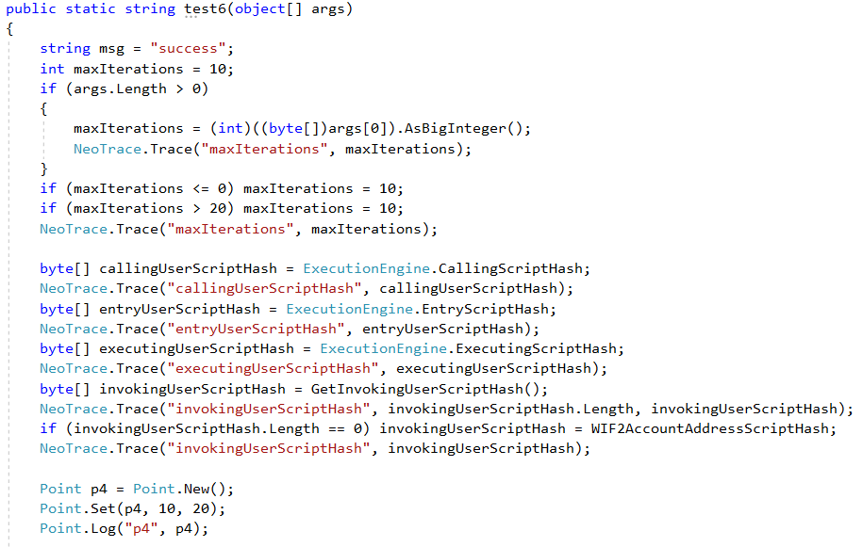
Test6() – Code

Slide 75
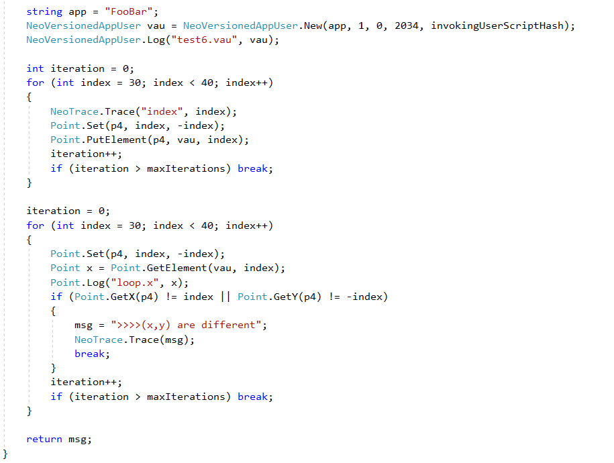
Test6() – Code (con’t)

Slide 76
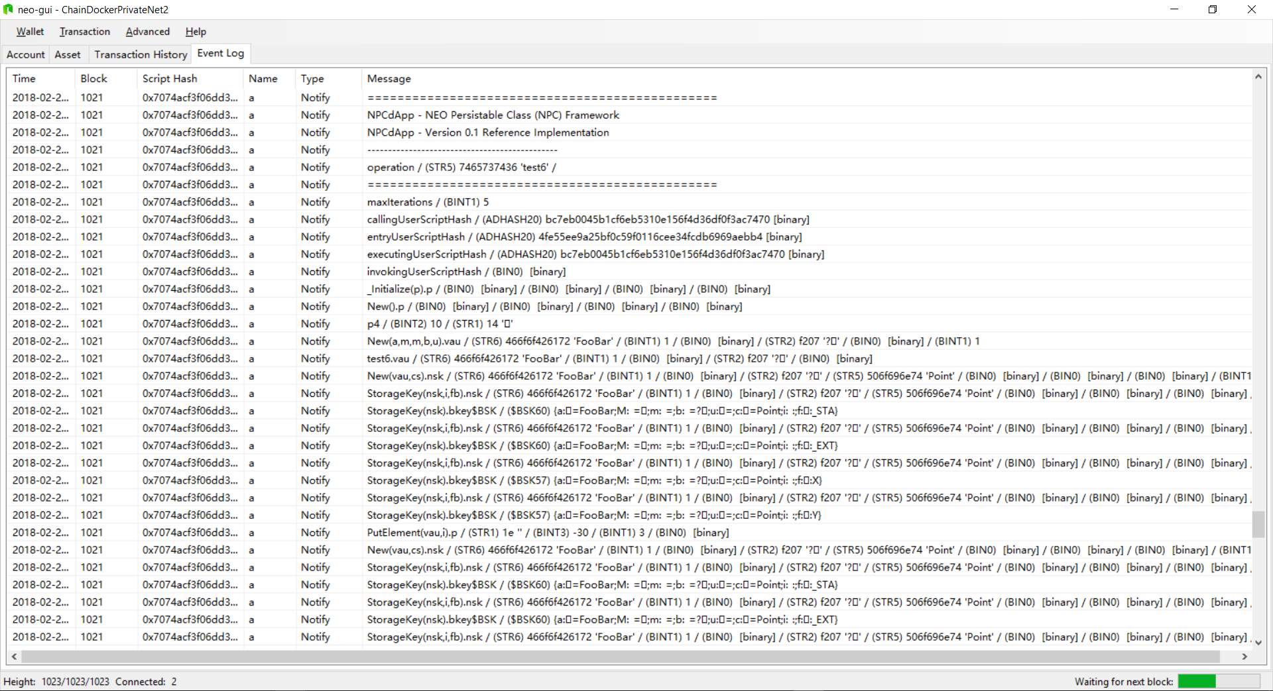
Test6() – neo-gui Event Log

Slide 77
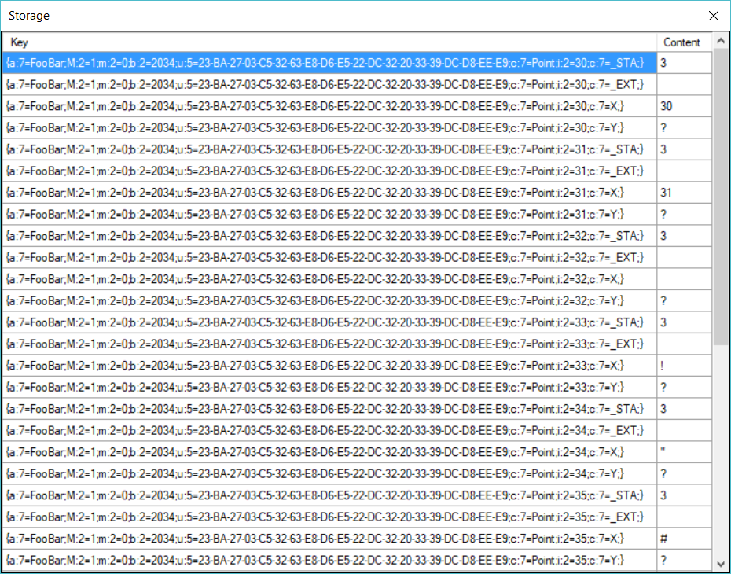
Test6() Results – neo-debugger Storage Viewer

Slide 78
8. Roadmap

Slide 79
8. Roadmap
Automatic Code Generation
In NPC 1.0, Point() was handcoded for each NPC Level but with an eye to being automatically generated in the future
Add support for Storage.Delete()
Simply overlooked in NPC 1.0
Level 5 Extendible
Support entity extension capabilities for existing entities living in deployed smart contracts
Level 6 Authorized
Support for to support authenticated and role-based authorization to entities you create (and others create)
Level 7 Optimized
Key space optimizations starting with NeoStorageKey compression

Slide 80
Roadmap: Automatic Code Generation
NPC Compiler (npcc.exe)
Compile .cs file something like the following into a DLL
Then pass the DLL plus NPC Level of persistence support you need to npcc.exe and a new expanded .cs file is created.
namespace NeoPesistenceClasses0
{
public class Point /* Level 0 - Basic */
{
private BigInteger _x;
private BigInteger _y;
}
}
Support for ___npcconfig class for emmbedded npcc configuration parameters (e.g. NPC Level)
Investigate support for partial classes in C#.NET

Slide 81
9. Summary

Slide 82
9. Summary
NPC Level 0 Basic
NPC Level 1 Managed
NPC Level 2 Persistable
NPC Level 3 Deletable (Bury/Tombstone)
NPC Level 4 Collectible
NPC Level 5 Extendible (Roadmap)
NPC Level 6 Authorized (Roadmap)
NPC Level 6 Optimized (Roadmap

Slide 83
Appendices

Slide 84
Appendix A - NEO Blockchain Architecture Reference Model (ARM)

Slide 85
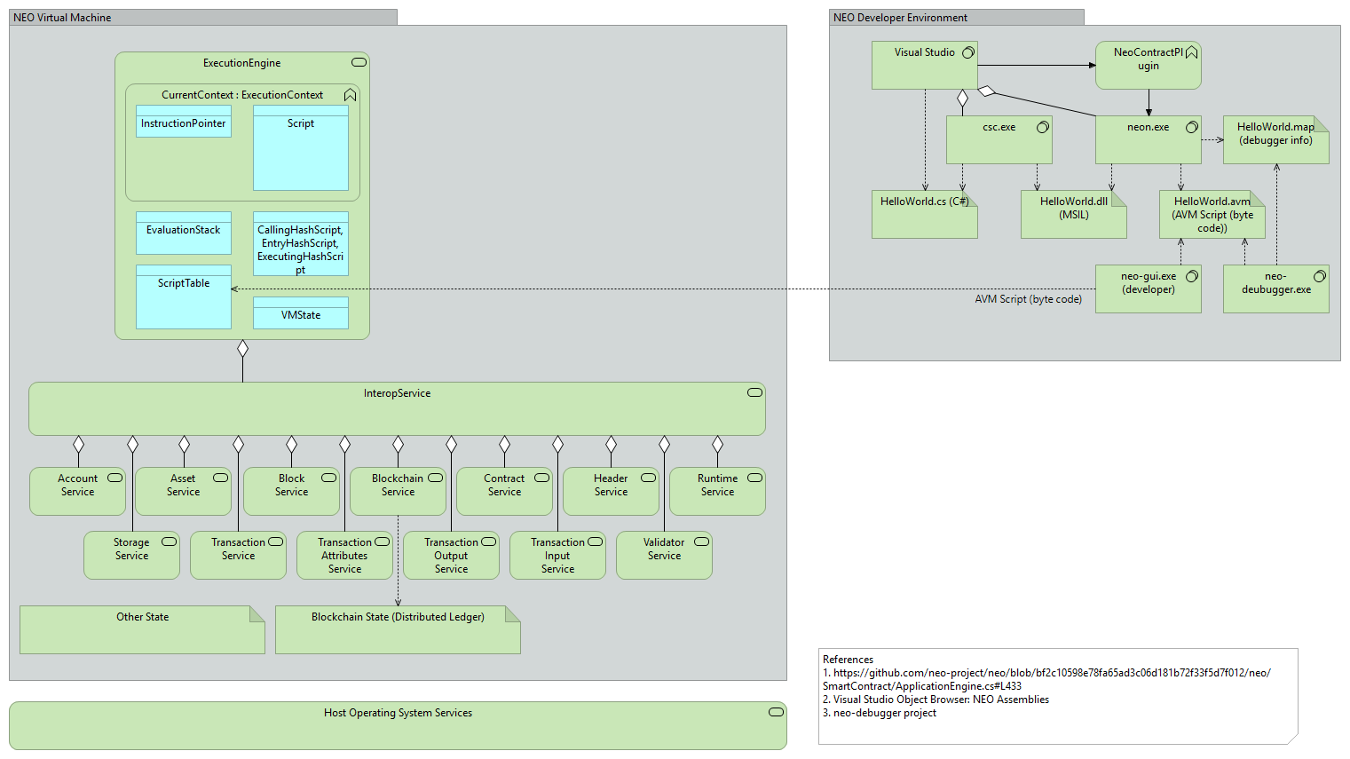
A - NEO Blockchain Architecture Reference Model (ARM)

Slide 86
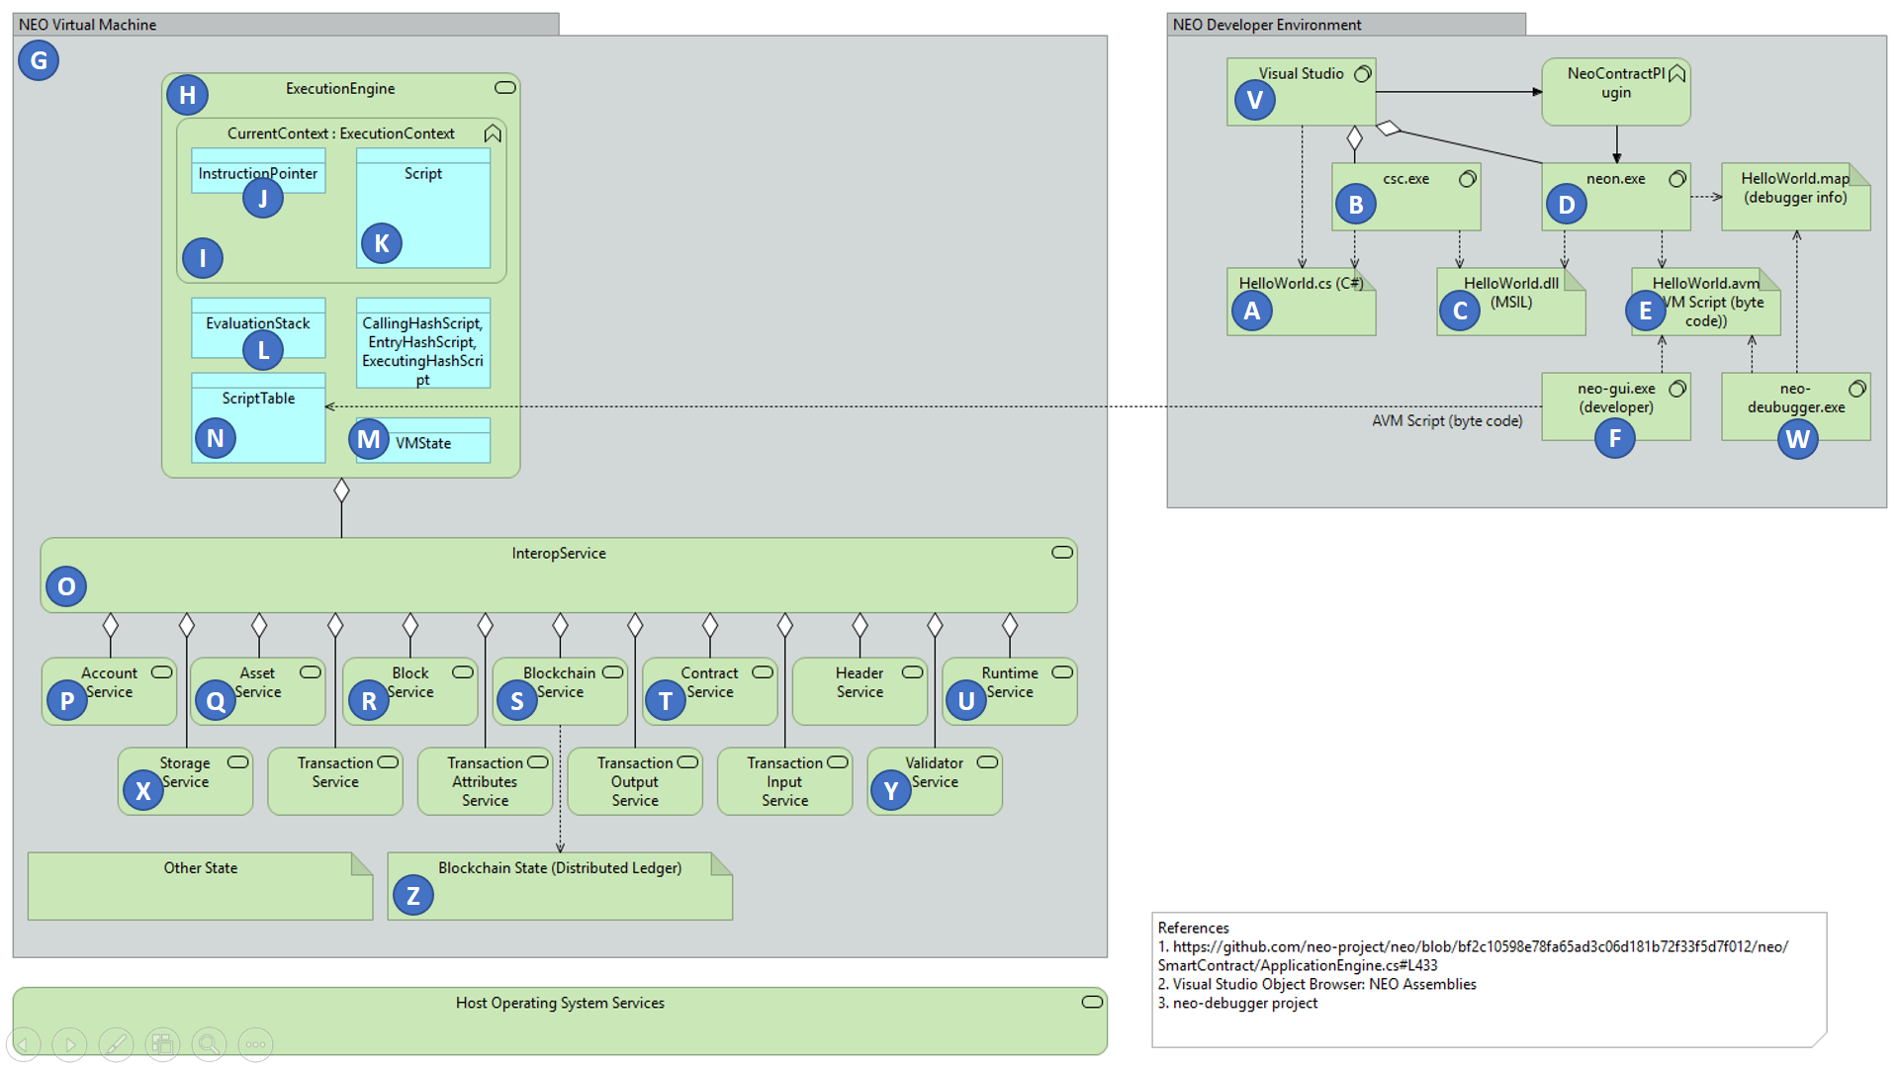
NEO Blockchain ARM

Slide 87
NEO Developer Environment

Slide 88
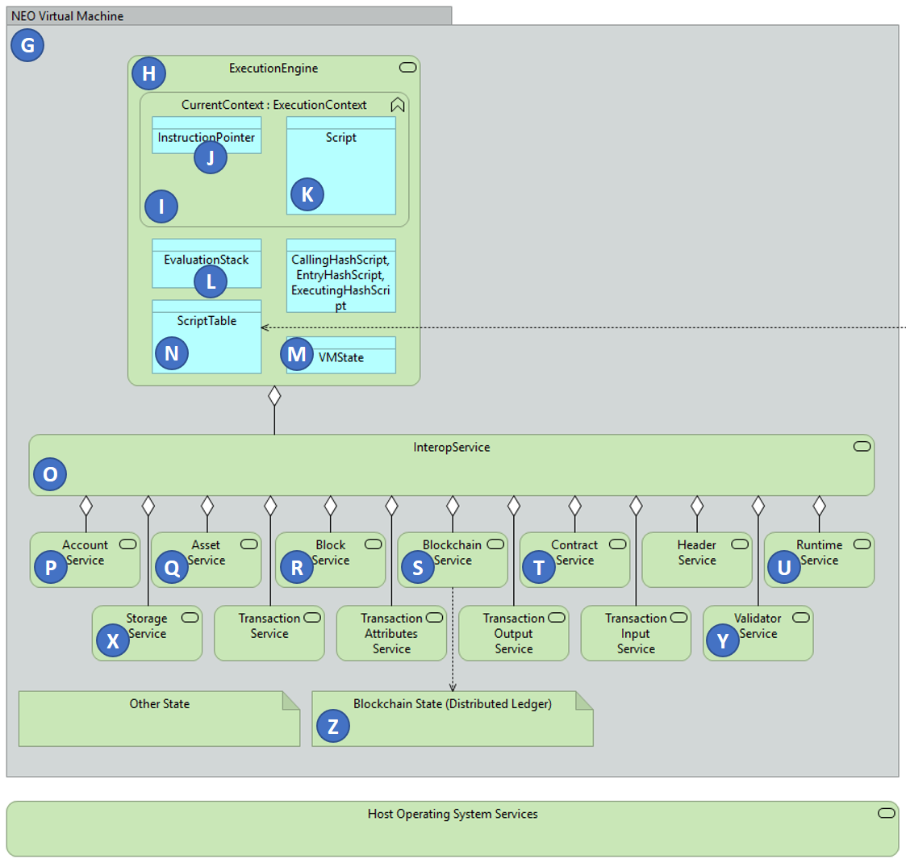
NEO Virtual Machine

Slide 89
Questions?
neotoronto@outlook.com

Slide 90
6. Solution

